Slide 1
SALES KIT

Slide 2
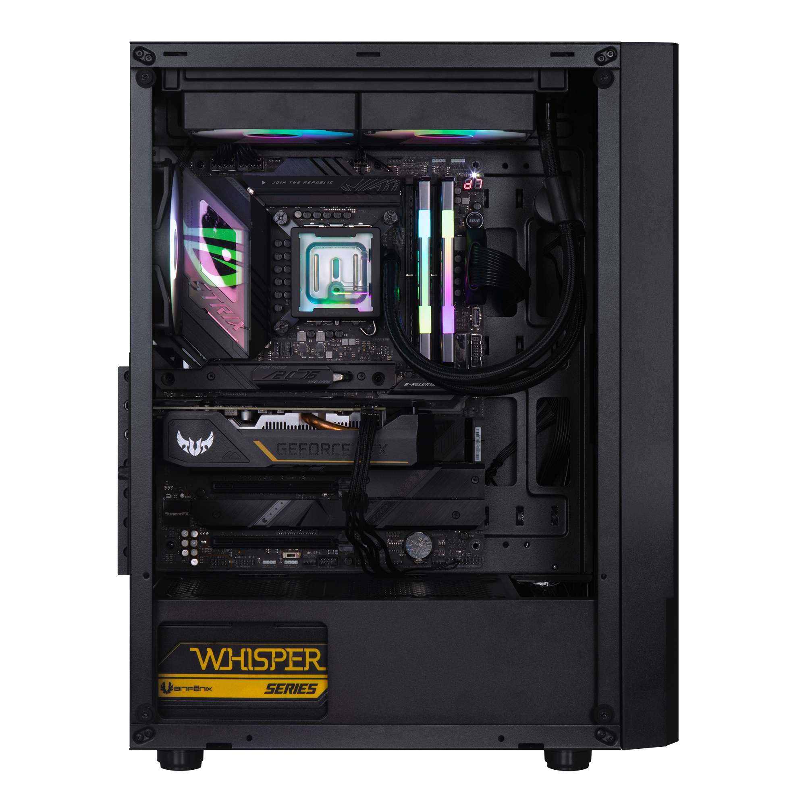
DIMENSIONS
Case : L373*W212*H470 mm
373mm
212mm
470mm

Slide 3
1 x USB 3.0, 2 x USB , Audio I/O

Slide 4
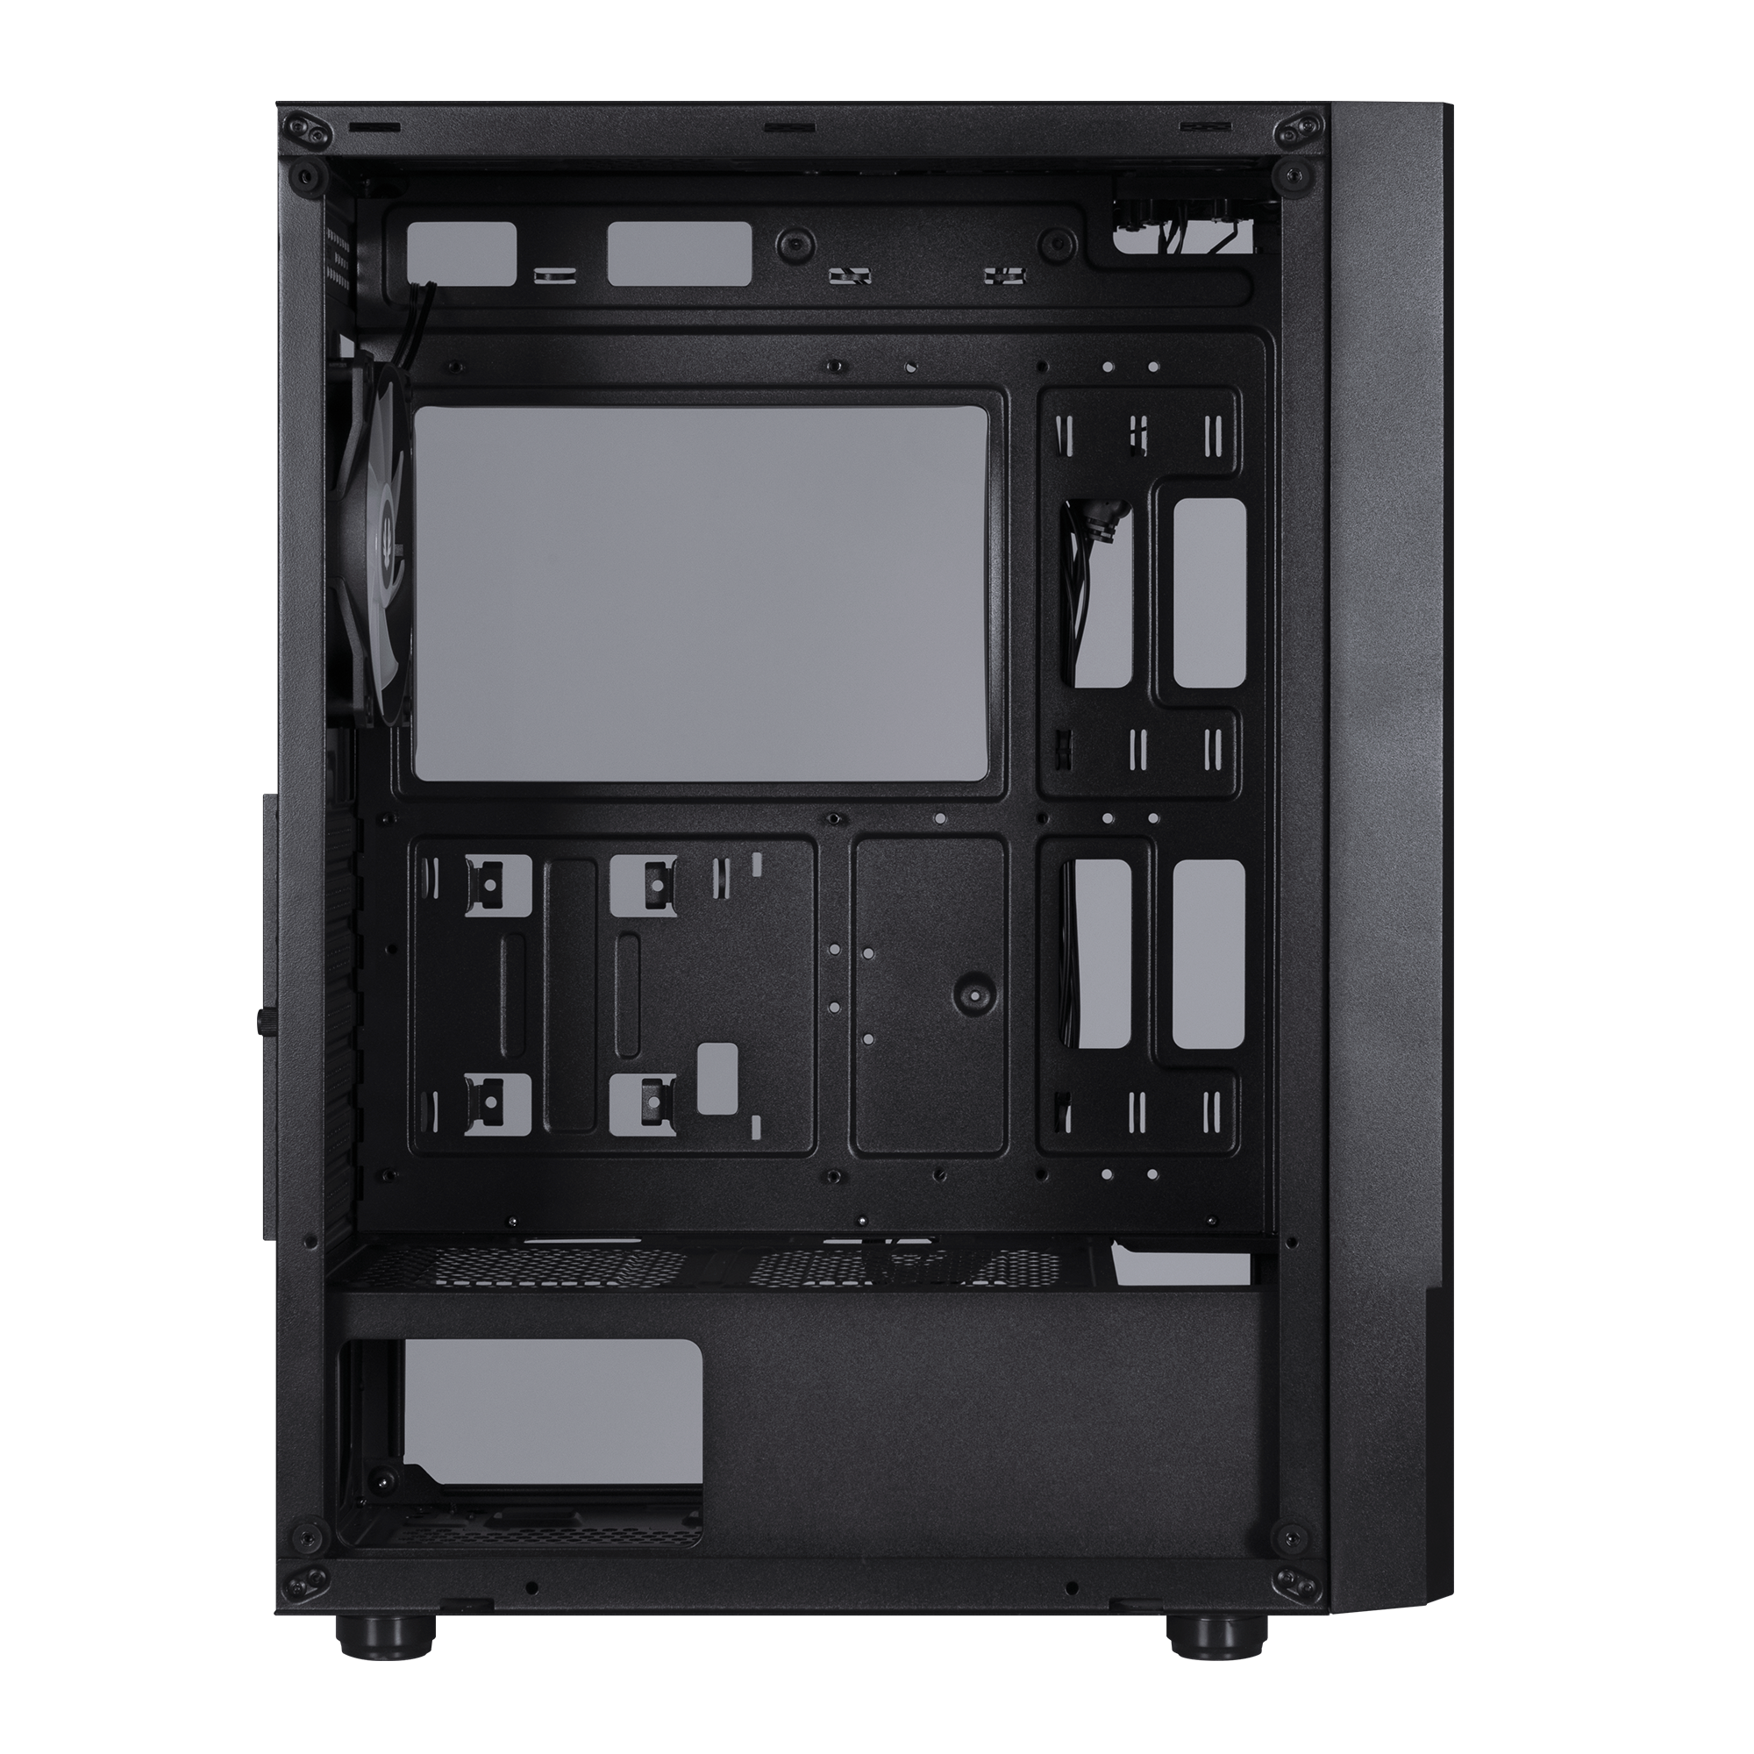
FAN CAPACITY
120 mm
140 mm
FRONT | 3 x 120mm or 2 x 140mm
TOP | 2 x 120mm or 2 x 140mm
REAR | 1 x 120mm

Slide 5
240mm x 1/ 280mm x 1
(Thickness up to 27mm)
360mm x 1
280mm x 1
240mm x 1
(Thickness up to 27mm)
120mm x 1
RADIATOR SUPPORT

Slide 6
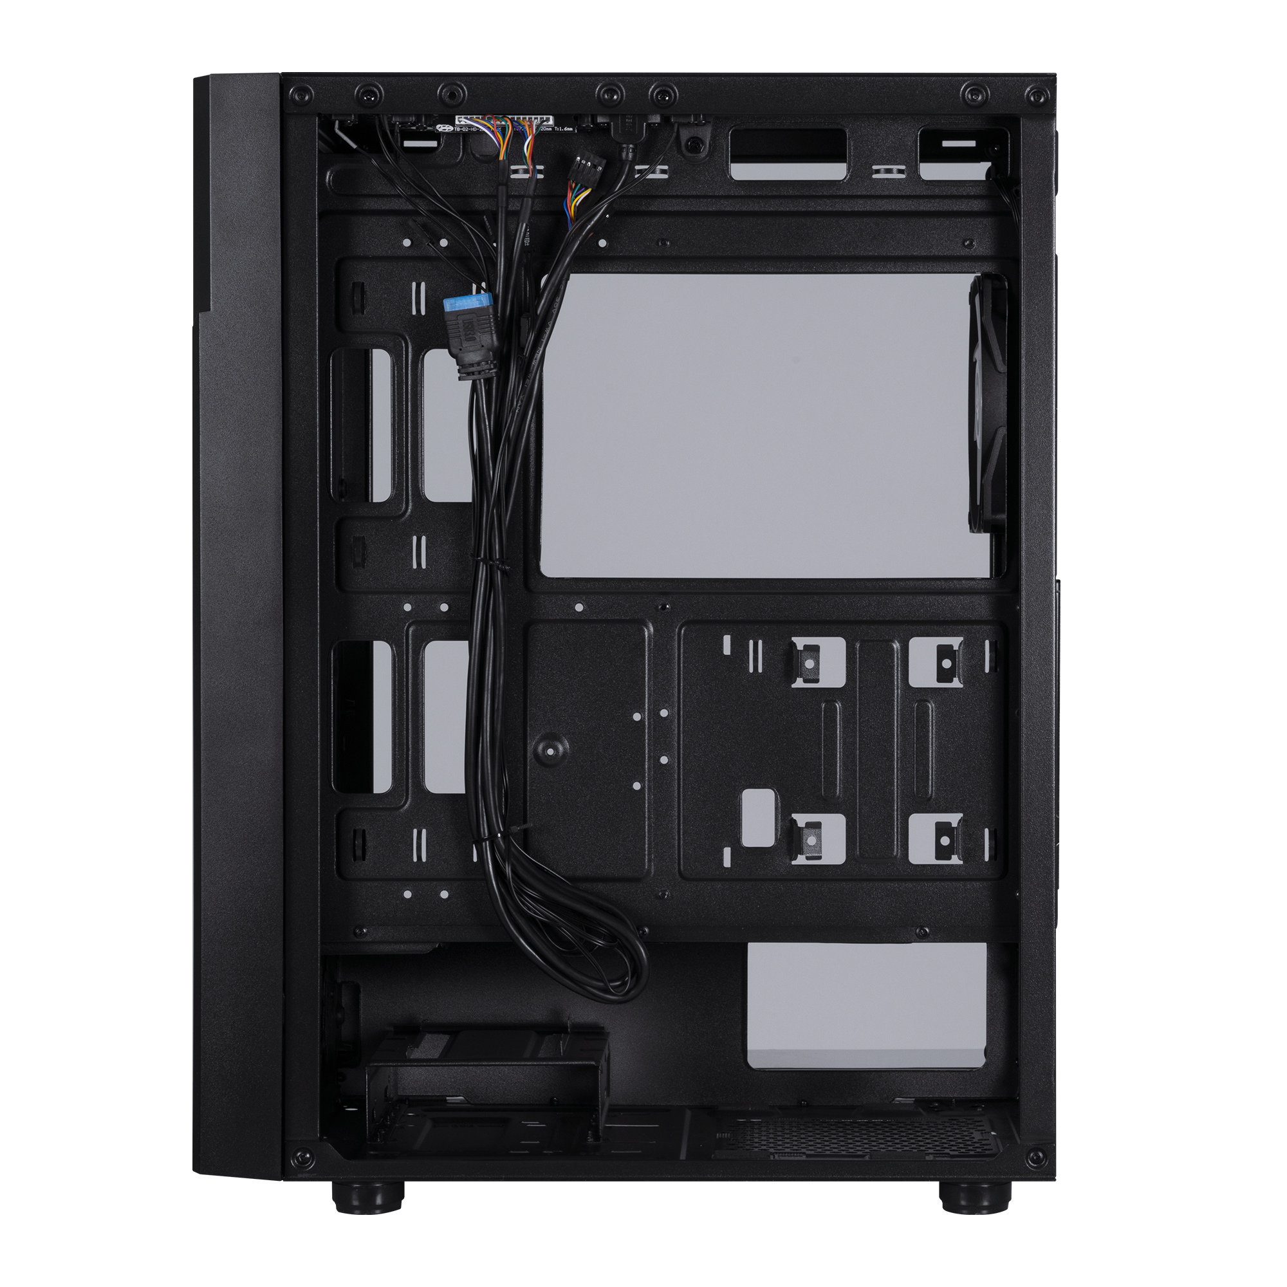
3X 2.5“ Drive
1X 3.5“ Drive

Slide 7
Air Cooler
Height Support
Mini-ITX
MicroATX
ATX
26mm
165mm
(305mm x244mm)
VGA Length Support
330mm
Cable Management Support
ATX & Standard
up to 200mm
(Suggest up to 185mm)

Slide 8
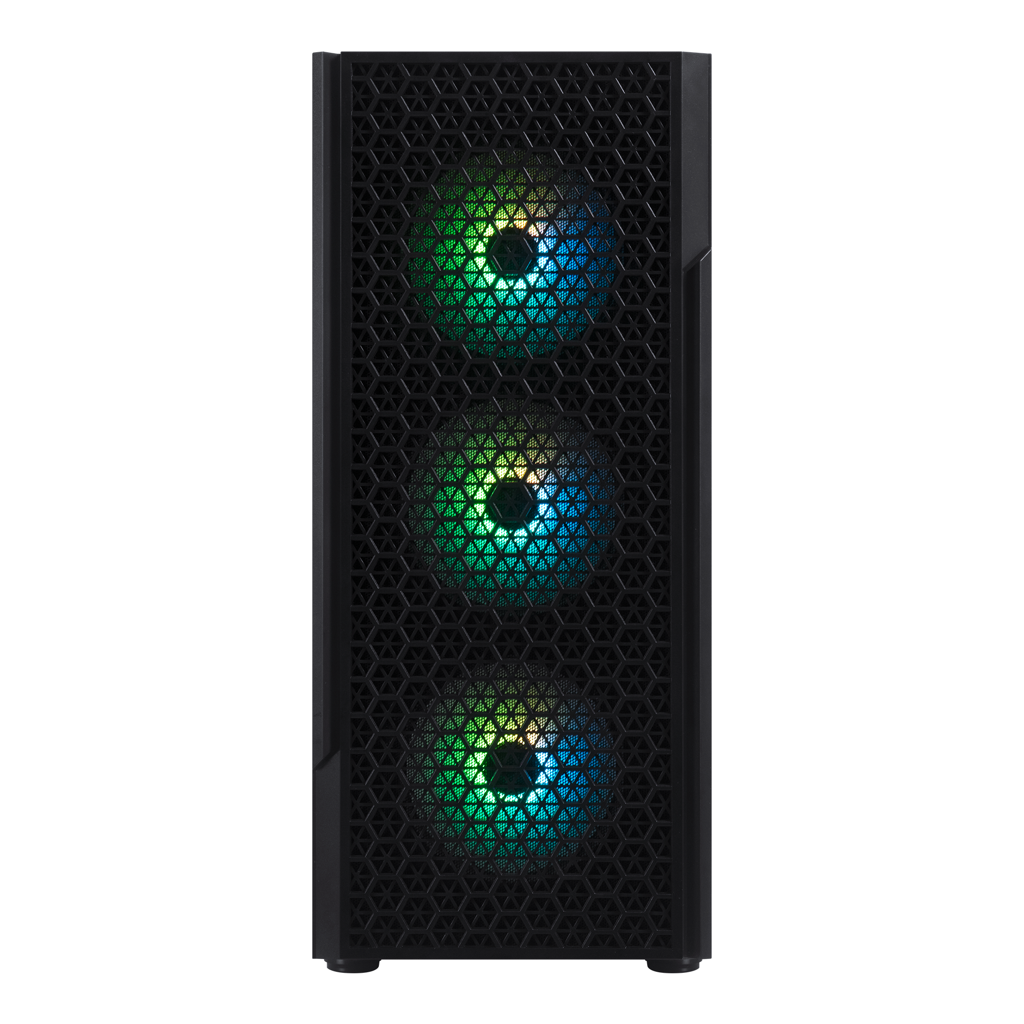
PROTON 4F-Black WITH BPA 600W
Part no. |  | BFC-PROBR6KKGSK-4F
Materials |  | Steel, Mesh, Plastic, Tempered Glass
Dimensions |  | Case: L373*W212*H470 mm
Motherboard Supports |  | Mini-ITX, MicroATX, ATX
Air Cooler Height Support |  | 165mm
VGA Length Support |  | 330mm
Cable Management Support |  | up to 26m
5.25" Drive Bay |  | 0
3.5" Drive Bay |  | 1
2.5" Drive Bay |  | 3
Fan mounts | Front | 3 x 120mm or 3 x 140mm
 | Top | 2 x 120mm or 2 x 140mm
 | Rear | 1 x 120mm
Included Cooling Fan | Front | 3 x 120mm F-RGB Fan (Black Frame)
 | Top
 | Rear | 1 x 120mm F-RGB Fan (Black Frame)
Radiator Support | Front | 360mm x 1/280mm x 1/ 240mm x 1 (Thickness up to 27mm)
 | Top | 240mm x 1/280mm x 1 (Thickness up to 27mm)
 | Rear | 120mm x 1
PCI-E Slots |  | 7 Slots
I/O Ports |  | 1 x USB 3.0, 2 x USB , Audio I/O
Power Supply |  | ATX & Standard / up to 200mm (Suggest up to 200mm)
‎Remark |  | CUFT: 2.38 CBM :0.067 Carton: L536*W274*H460 mm N.W: 5.4Kgs / G.W:6.5Kgs(w/o fans)
PROTON

