Slide 1
SALES KIT

Slide 2
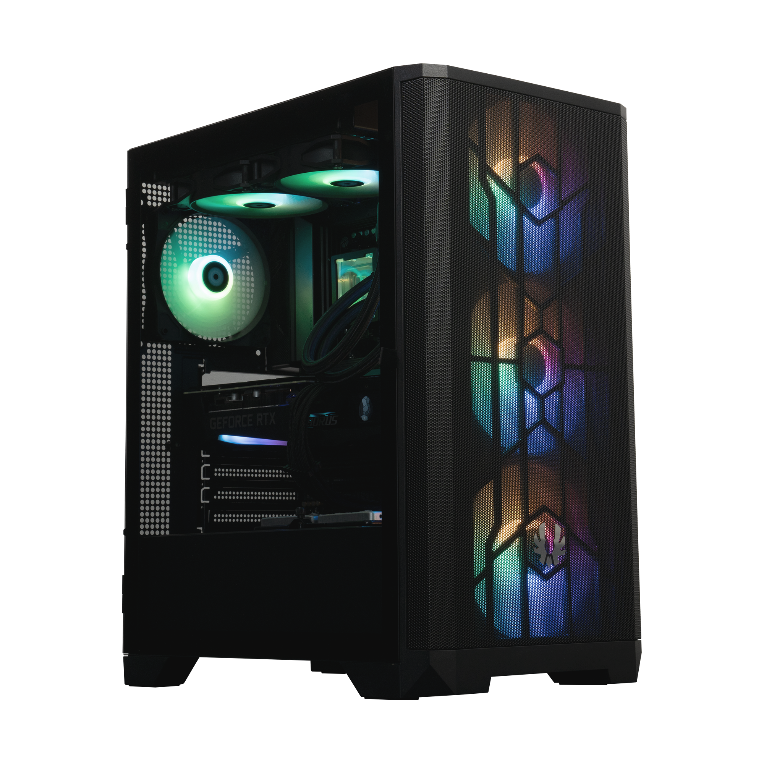
ABOUT
215mm
425mm
Dust Free Design
With Dust Filters
BOTTOM
480mm
TOP

Slide 3
I/O Ports
HD AUDIO
MIC
2X
USB3.0
RESET
POWER

Slide 4
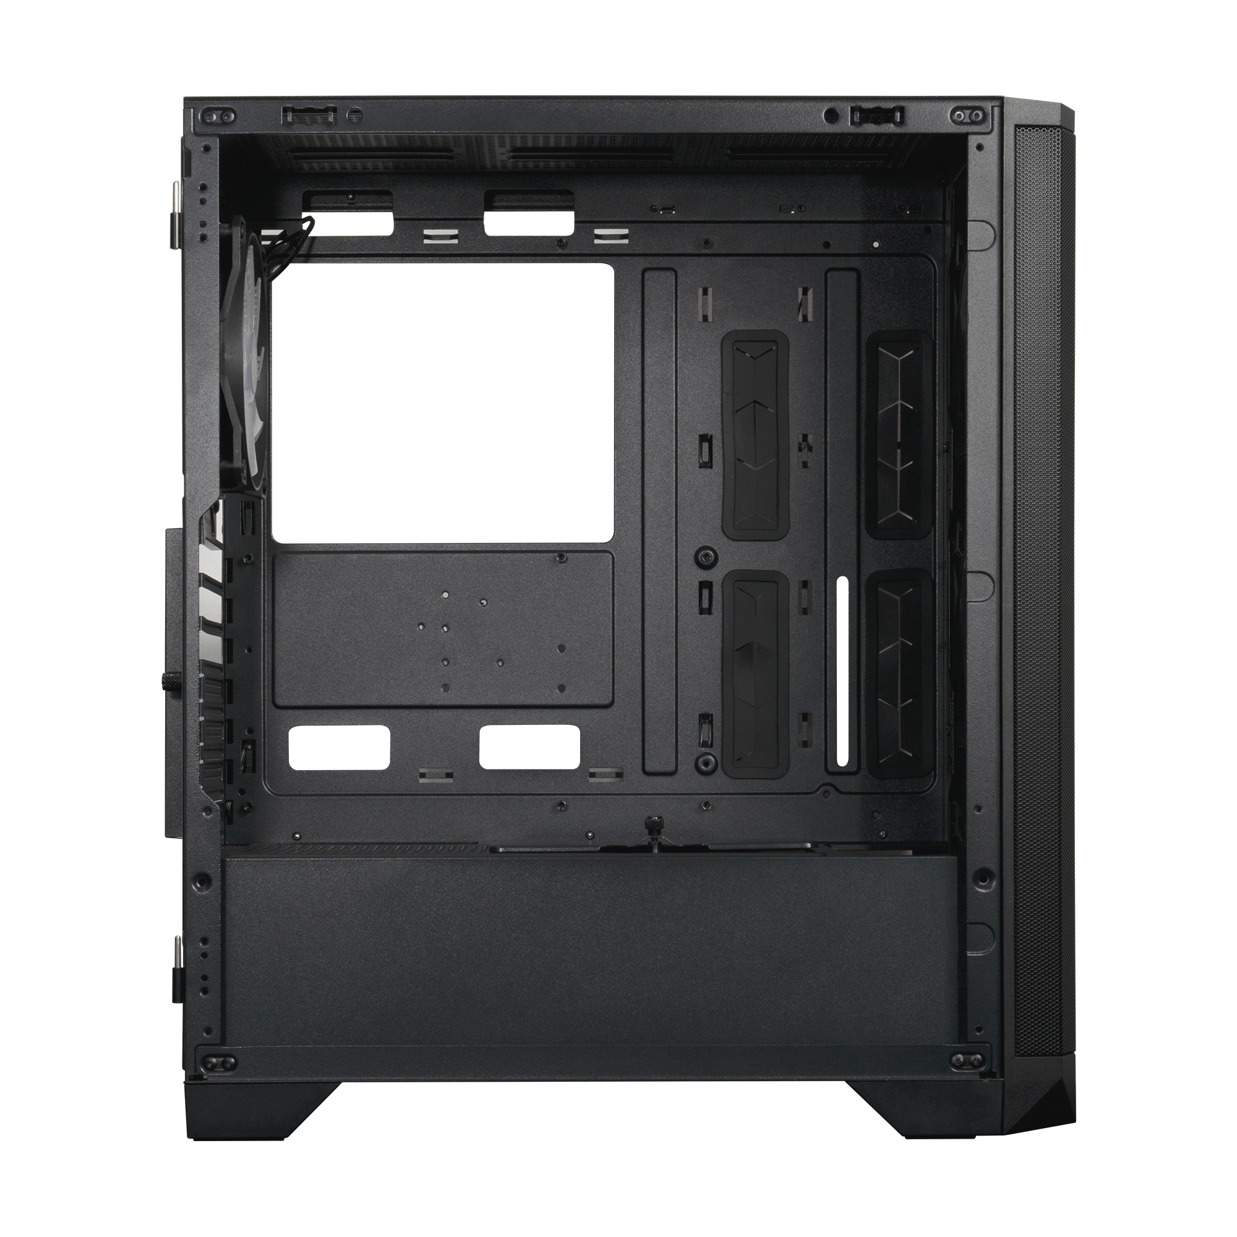
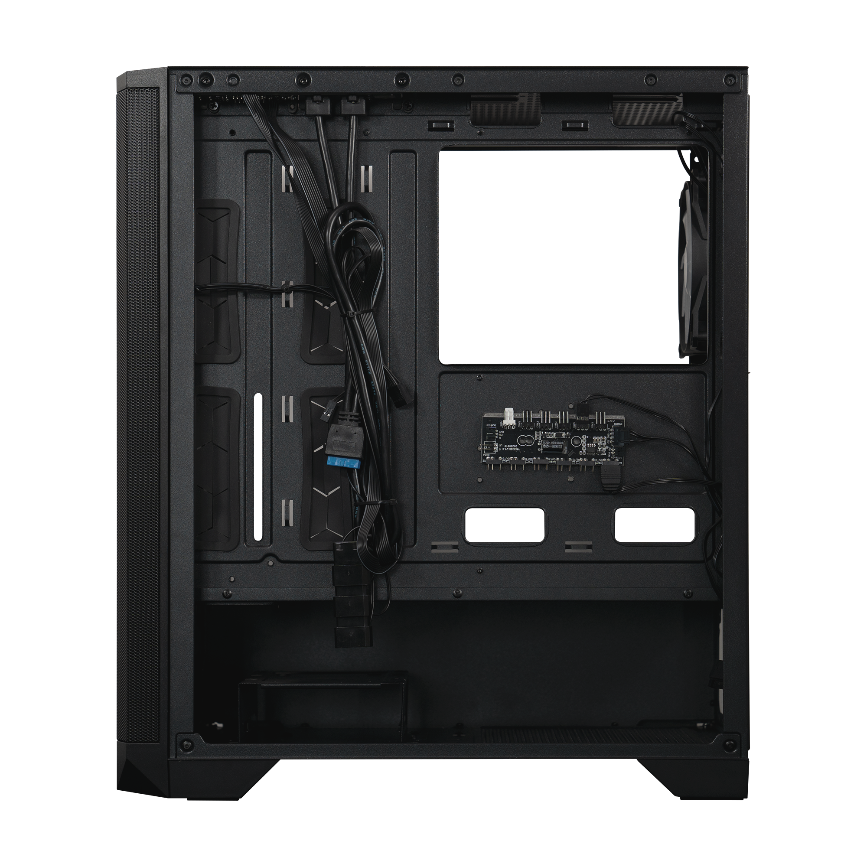
Space-Efficient
Interior
2X
OR
1X
2.5”SSD
3.5”HDD
1X
2.5”SSD
&
OR
2X
3.5”HDD
1X
3.5”HDD

Slide 5
A
Motherboard Support
A
D
Mini-ITX, Micro ATX, ATX
CPU Cooler Height
B
B
≤ 185mm
C
C
Max. VGA Card Length
≤ 357mm
D
Front Radiator Space
Thickness up to 27mm

Slide 6
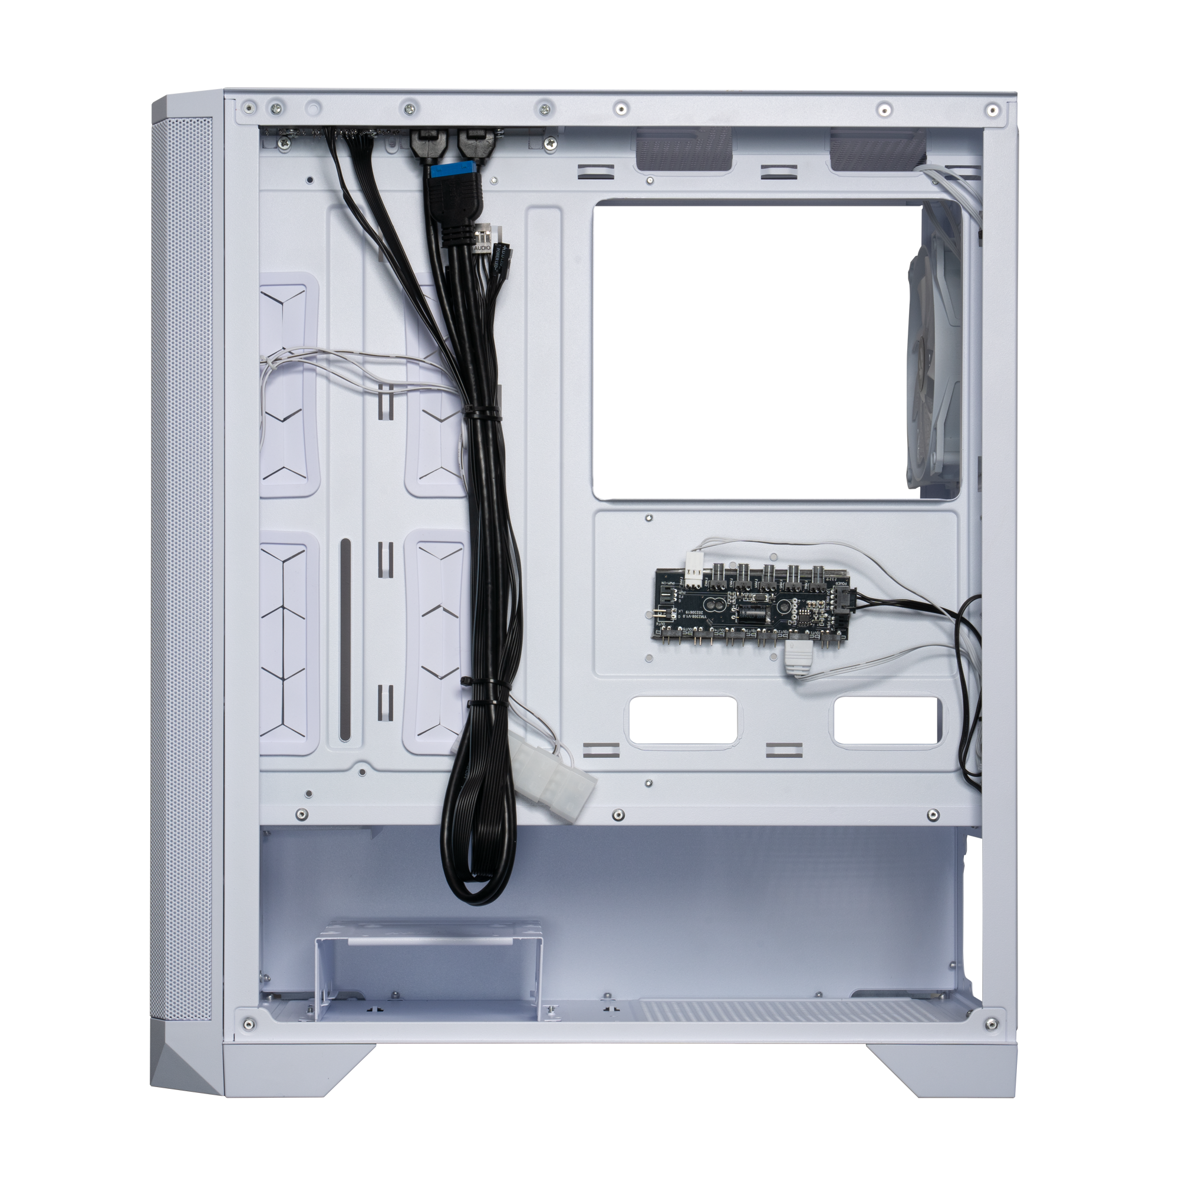
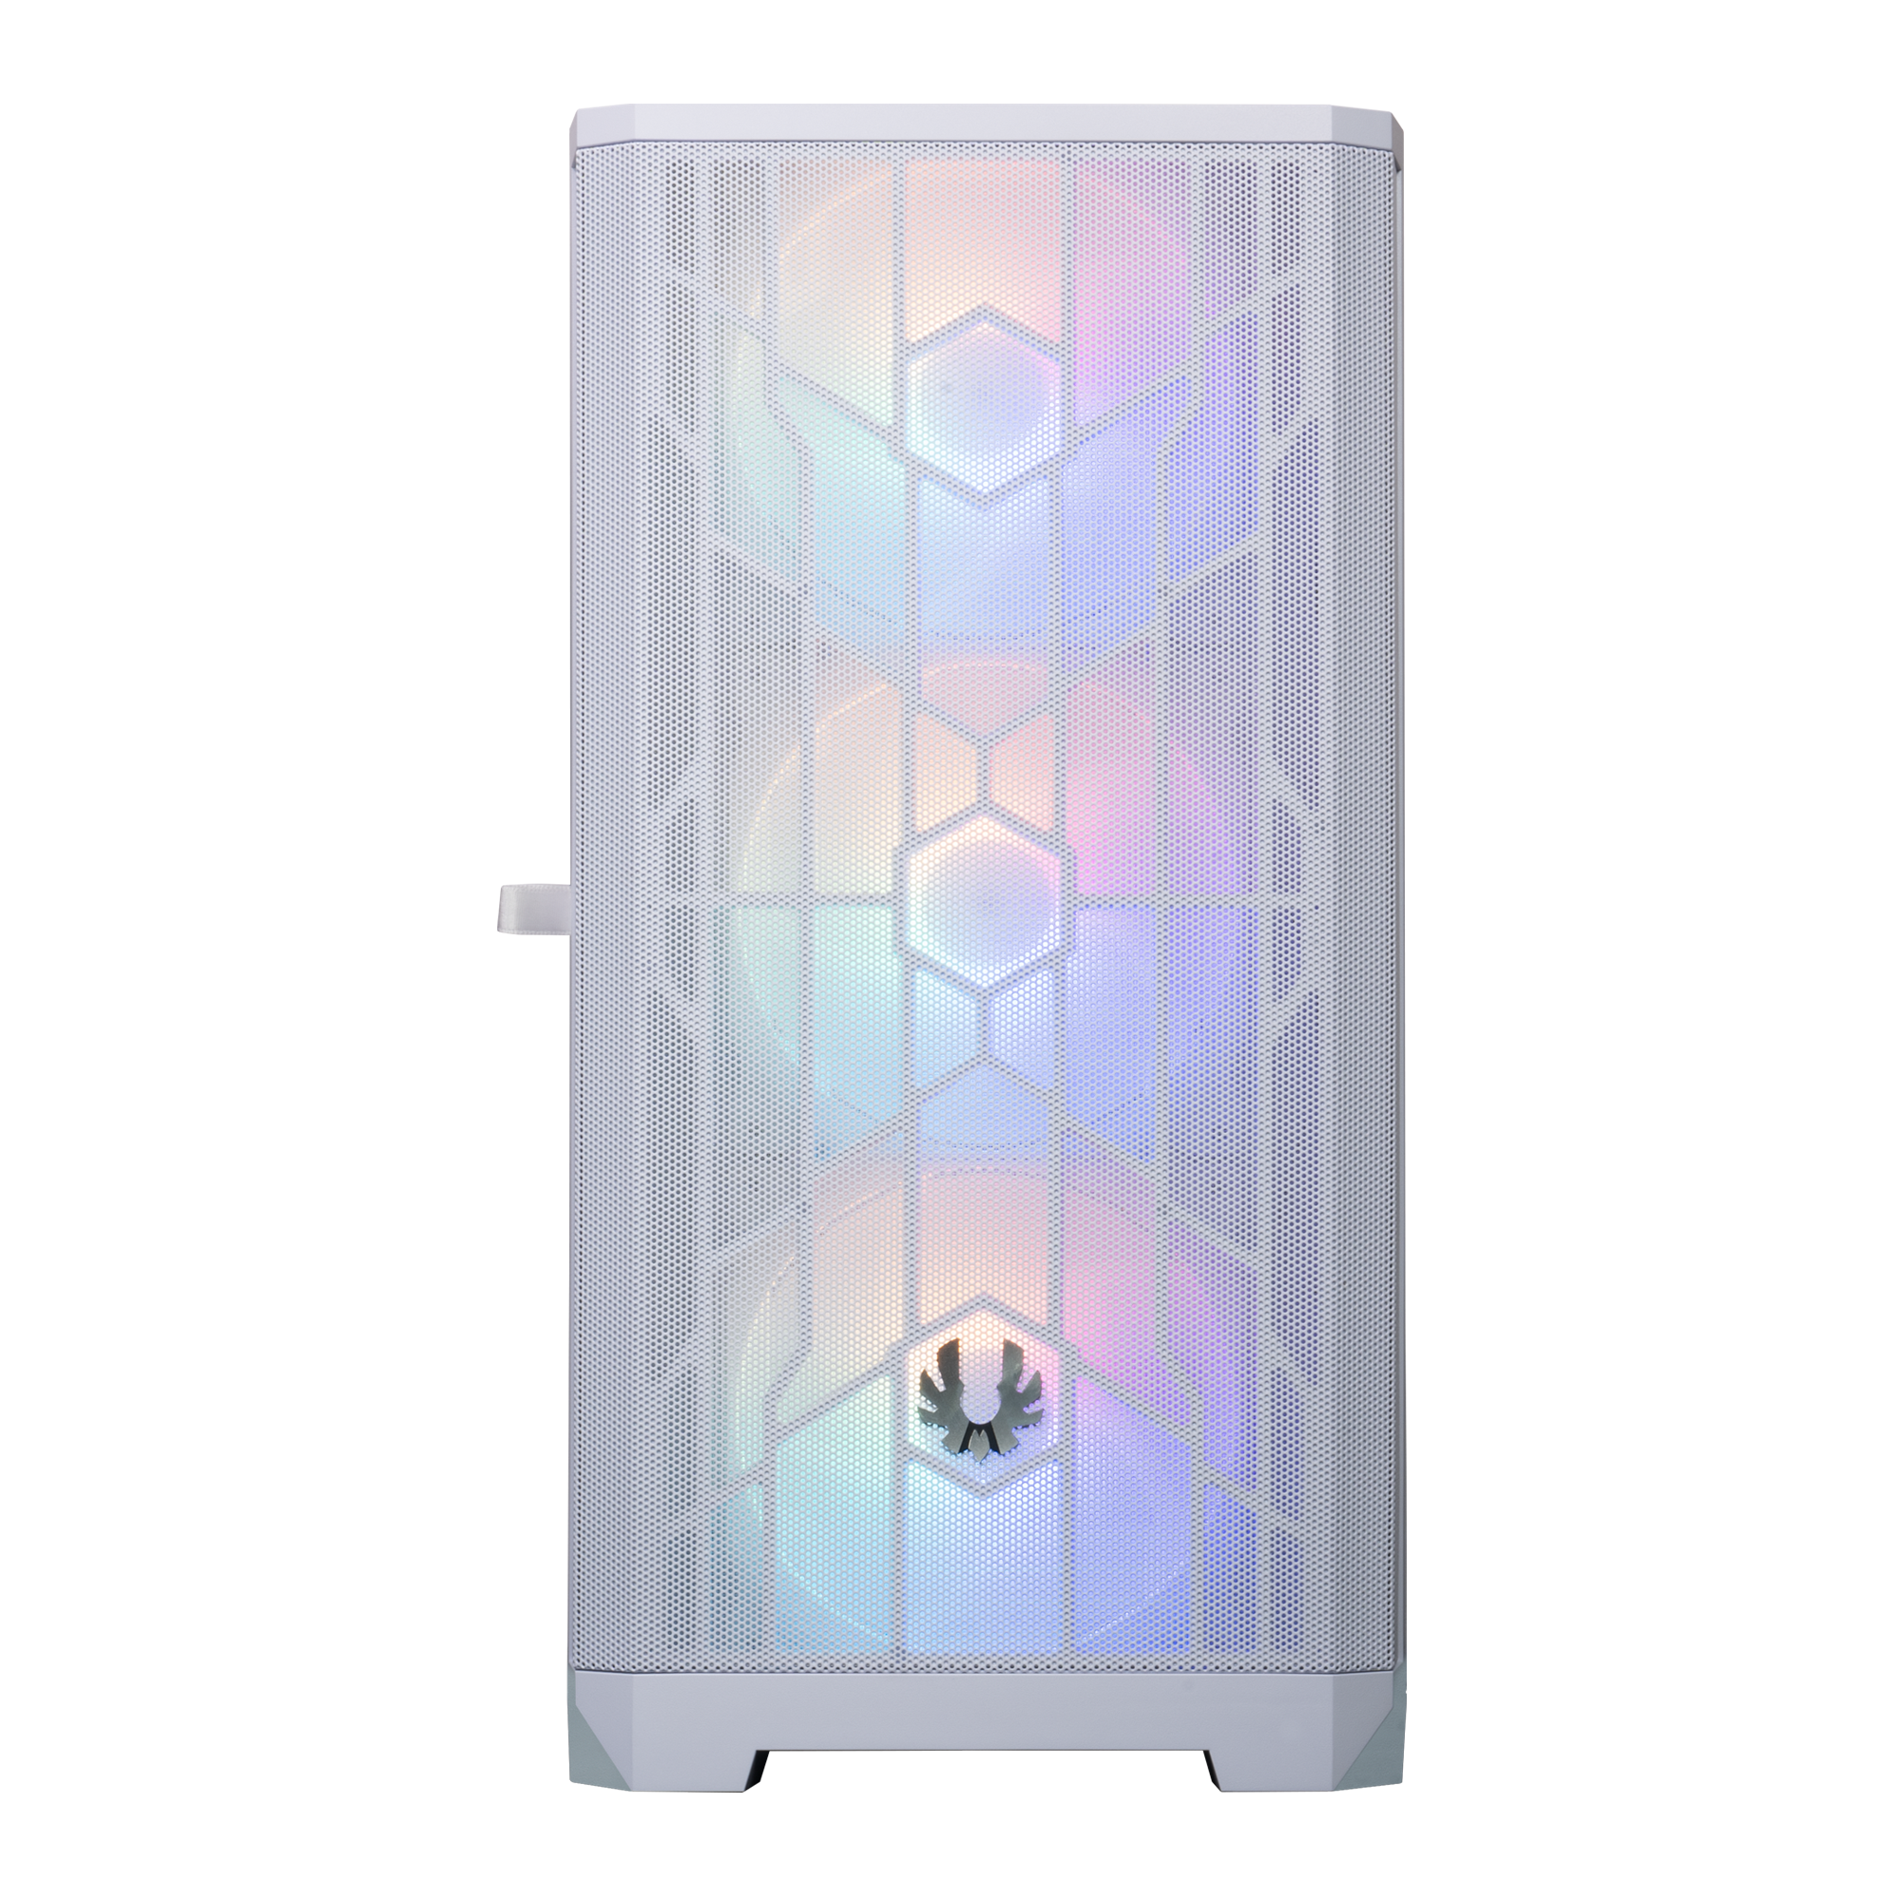
F
E
Max PSU Length
≤ 200mm
F
Cable management Space
up to 32.5mm
E

Slide 7
120 mm
140 mm
FRONT
3 x 120mm or 2 x 140mm
TOP
2 x 120mm or 2 x 140mm
REAR
1 x 120mm or 1 x 140mm

Slide 8
RADIATOR CAPACITY
240 mm
280 mm
240 mm
280 mm
360 mm
120 mm
140 mm
120 mm
240 mm
280 mm
360 mm

Slide 9
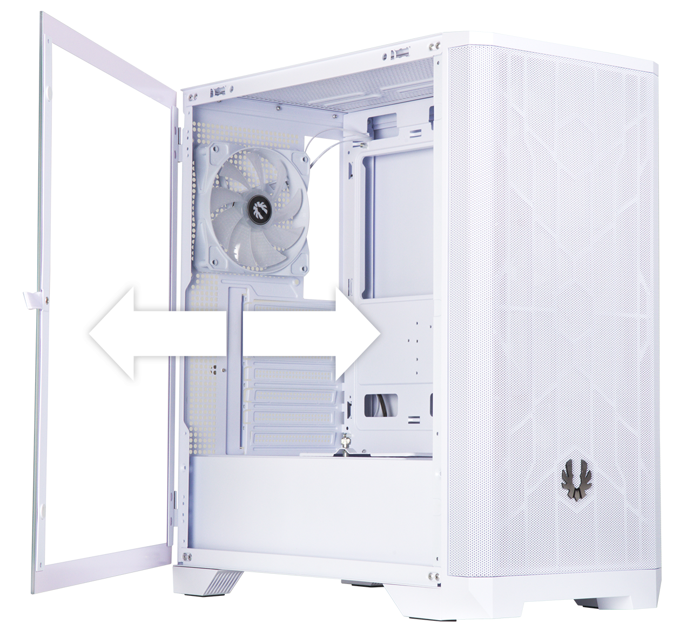
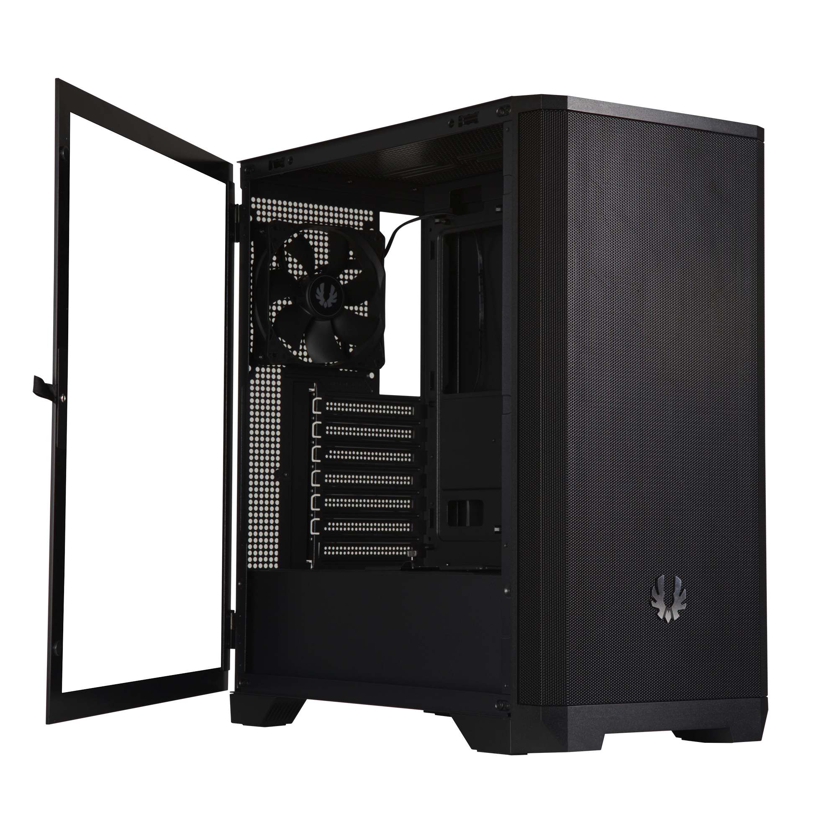
Tempered Glass Side Panel with Hinge

Slide 10
 |  | NOVA MESH SE TG 4A-Black | NOVA MESH SE TG 4A 4A-White
Part no. |  | BFC-NSE-300-WWGKW-4A | BFC-NSE-300-KKGSK-4A
EAN |  | 4712883217548 | 4712883217555
UPC |  | 886027157848 | 886027157855
Net weight (NW) Gross weight (GW) |  | N.W:5.4Kgs / G.W:6.4Kgs | N.W:5.4Kgs / G.W:6.4Kgs
Materials |  | Steel, Mesh, Plastic, Tempered Glass
Chassis Dimensions (W x H x D) |  | L417*W230*H460 mm
Motherboard Supports |  | Mini-ITX, MicroATX, ATX
Air Cooler Height Support |  | 185mm
VGA Length Support |  | 357mm
Cable Management Support |  | up to 32.5m
3.5" Drive Bay |  | 2+1
2.5" Drive Bay |  | 2+1
Fan mounts | Front | 3 x 120mm or 2 x 140mm
 | Top | 2 x 120mm or 2 x 140mm
 | Rear | 1 x 120mm or 1 x 140mm
Radiator Support | Front | 360mm x 1/280mm x 1/ 240mm x 1 (Thickness up to 27mm)
 | Top | 280mm x 1/ 240mm x 1 (Thickness up to 27mm)
 | Rear | 120mm x 1
PCI-E Slots |  | 7 Slots
I/O Ports |  | 2 x USB 3.0, Audio I/O
Power Supply |  | ATX & Standard / up to 200mm (Suggest up to 200mm)

